Slide 1
The Separation of Powers
Courts Service Pilot: Lesson 5

Slide 2
Learning Outcomes
To be able to understand and explain the importance of the Irish Constitution.
To be able to identify and describe the role of each of the three separate branches of government.
To be able to explain the “separation of powers” and demonstrate how difficulties can arise when the executive fails to promote legislation.
To understand how statute laws are enacted.
To be able to distinguish statute law from common law (judge made law) and know where and how to locate Irish case law and statute law.

Slide 3
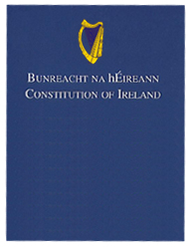
What is the Constitution of Ireland?
The fundamental law of the State.
Provides the framework for the State functioning & the administration of justice by the Courts.
Protects the fundamental rights of citizens & the relationship between the 3 branches of government.
Notes:
Hyperlinked picture to Pdf Irish Constitution.

Slide 4
The 3 Branches of Government
Legislature
This is the Oireachtas and it legislates for the good of the people.
It consists of the President and 2 houses: Dail Eireann & Seanad Eireann.
Executive
This is the government and consists of An Taoiseach and Ministers
The governments role is administrative.
Judiciary
The judiciary are judges appointed by the President (Article 35.1) who administer justice in the courts.
“Justice shall be administered by judges in courts established by law”(Article 34.1).
The people elect the President and representatives (T.D.’s) to the Dail.
It formulates policies, promotes legislation and directs the operations of various departments.
The present chief Justice is Chief Justice Susan Gageby Denham.
Notes:
The role of the Chief Justice Hyperlinked Judiciary Picture.

Slide 5
Powers: The Legislature, Executive & Judiciary
The Executive makes the law operative
The Judiciary Interprets the Law.
Legislature Passes the Law

Slide 8
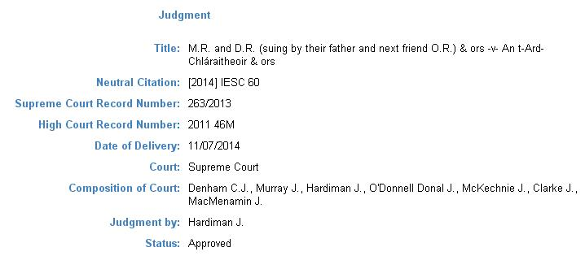
Notes:
Quote linked to Chief Justice Susan Denham’s Judgment.

Slide 9
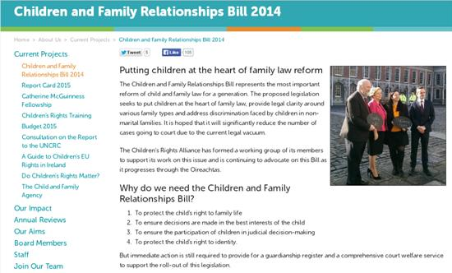
Notes:
Picture Hyperlinked to Bill.

Slide 10
Origins of Laws
All laws made in Ireland must conform to the Constitution, and are interpreted in light of the Constitution.
Other sources of law:
Statute Law(Acts)
Common Law (Judge made law)
European Law
International Law
Notes:
Courts Service DVD Lesson 5

Slide 11
Statute Law
How a Bill becomes Law
Understanding case law citations
Notes:
Picture hyperlinked to Statute Book

Slide 12
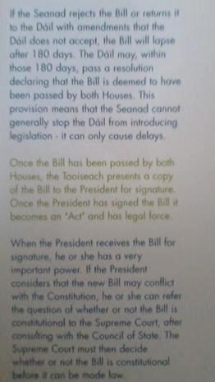
How a Bill becomes Law ?
Statute law (“Acts of the Oireachtas”) begin as a Bill which is the Executives proposal for legislation.
A Bill passes five stages before it becomes an Act

